Slide 1
Photo-Realistic Single Image Super-Resolution Using a Generative Adversarial Network
JONGWOOK-SI
Kumoh National Institute of Technology, Korea
Dept. Of Computer Engineering

Slide 2
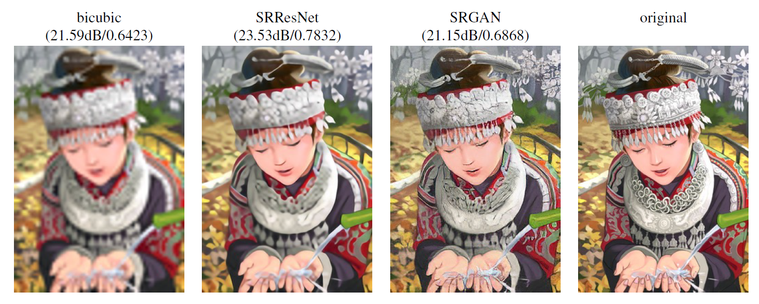
SRGAN
Image Resolution
Realistic

Slide 3
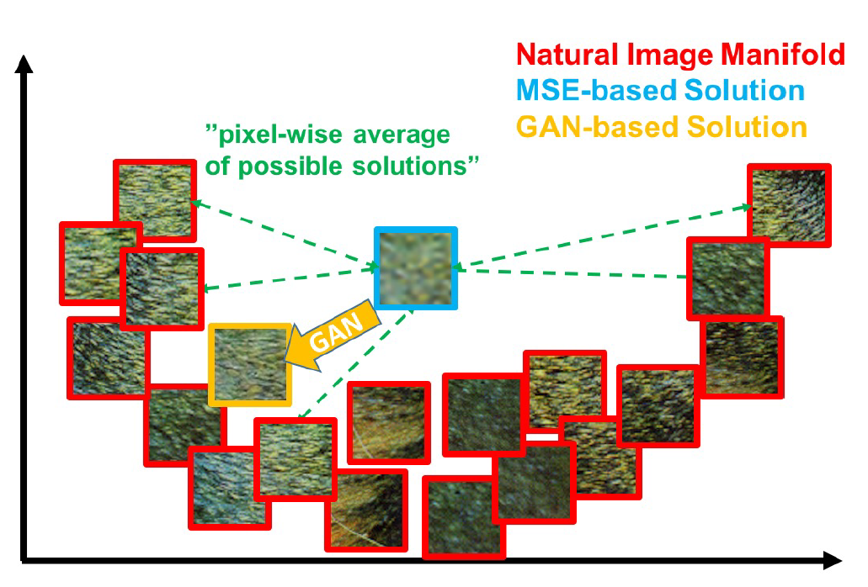
SRGAN
MSE
Minimizing MSE encourages finding pixel-wise averages of plausible solutions which are typically overly-smooth and thus have poor perceptual quality

Slide 4
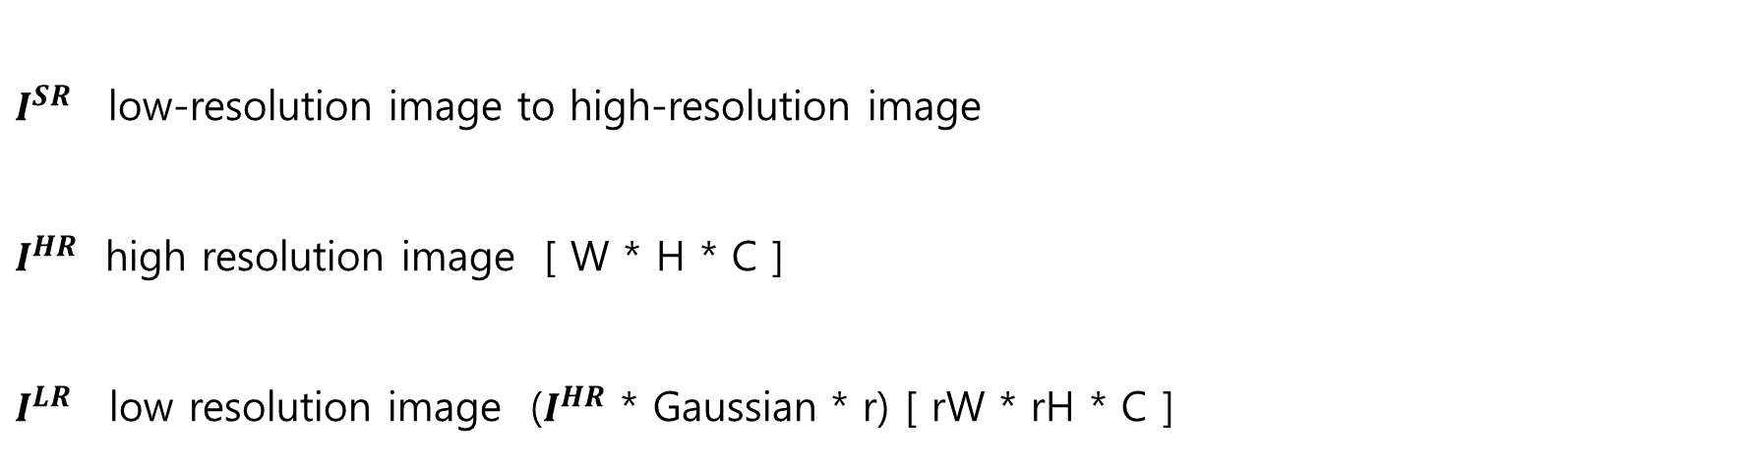
SRGAN
Training
$I^{SR}$low-resolution image to high-resolution image
$I^{HR}$ high resolution image [ W * H * C ]
$I^{LR}$ low resolution image ($I^{HR}$ * Gaussian * r) [ rW * rH * C ]

Slide 5
SRGAN
DownSampling Algorithm
- Reduction Image Size
OutImage[newi][newj] = (InputImg[i][j] + InputImg[i+1][j] +
InputImg [i][j+1] + InputImg[i+1][j+1]) / r

Slide 6
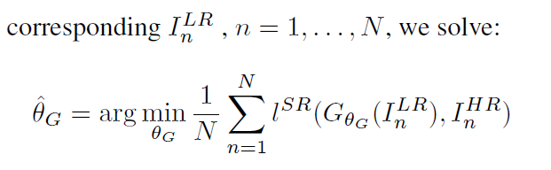
SRGAN
Training

Slide 7
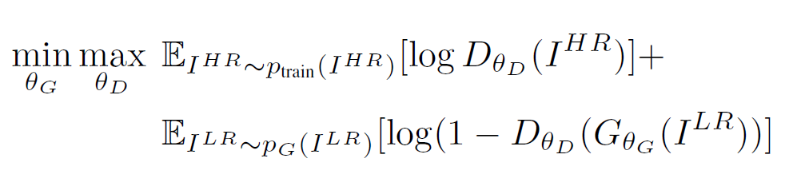
SRGAN
Training

Slide 8
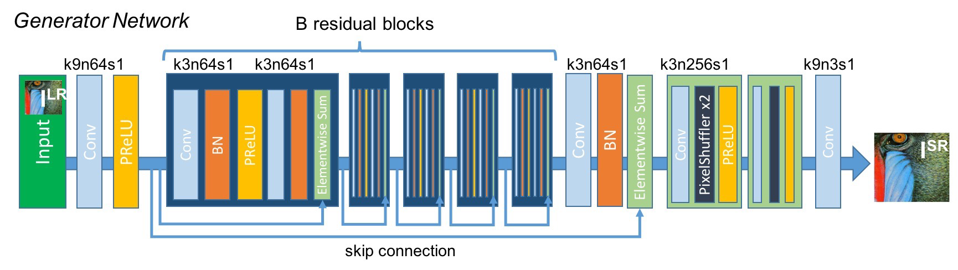
SRGAN
Generator Network

Slide 9
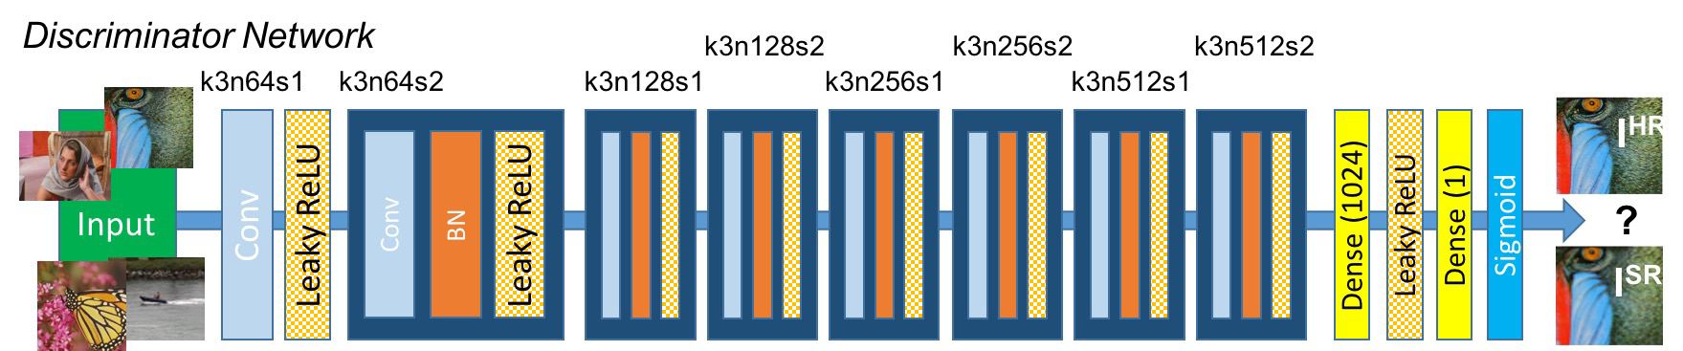
SRGAN
Discriminator Network

Slide 10
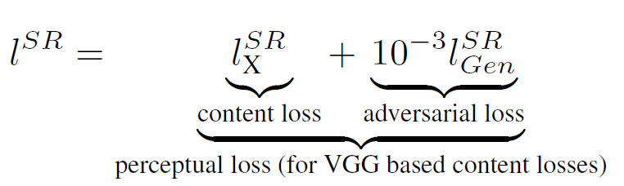
SRGAN
Perceptual loss function

Slide 11
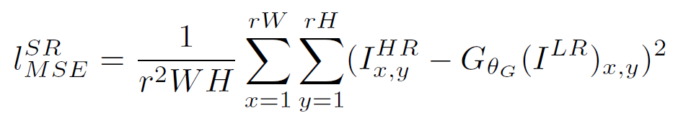
SRGAN
Content loss (MSE)

Slide 12
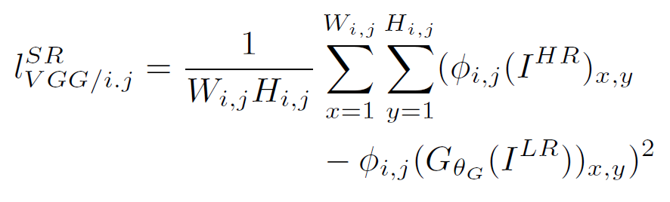
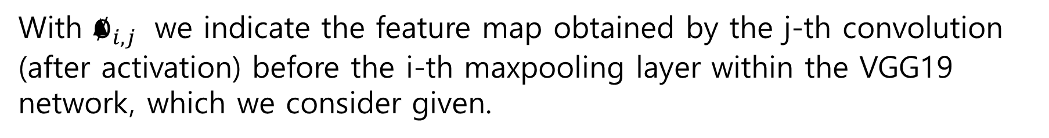
SRGAN
Content loss (VGG loss)
With $∅_{i,j}$ we indicate the feature map obtained by the j-th convolution (after activation) before the i-th maxpooling layer within the VGG19 network, which we consider given.

Slide 13
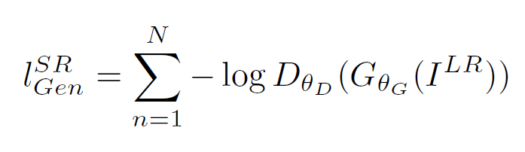
SRGAN
Adversarial loss

Slide 14
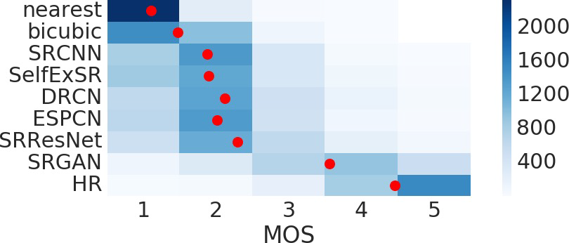
SRGAN
MOS
Asking 26 raters to assign an integral score from 1 (bad quality) to 5 (excellent quality) to the super-resolved images.

Slide 15
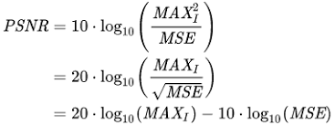
SRGAN
PSNR
- The ratio of noise to the maximum signal a signal can have. - Used to evaluate picture loss information in loss compression

Slide 16
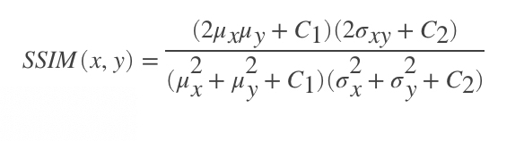
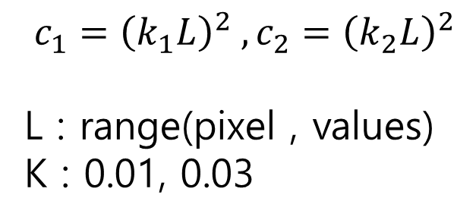
SRGAN
SSIM
$$c_{1}={\left(k_{1}L\right)}^{2} , c_{2}={\left(k_{2}L\right)}^{2}$$
L : range(pixel , values)
K : 0.01, 0.03
A method of measuring similarity of the original image against distortion

Slide 17
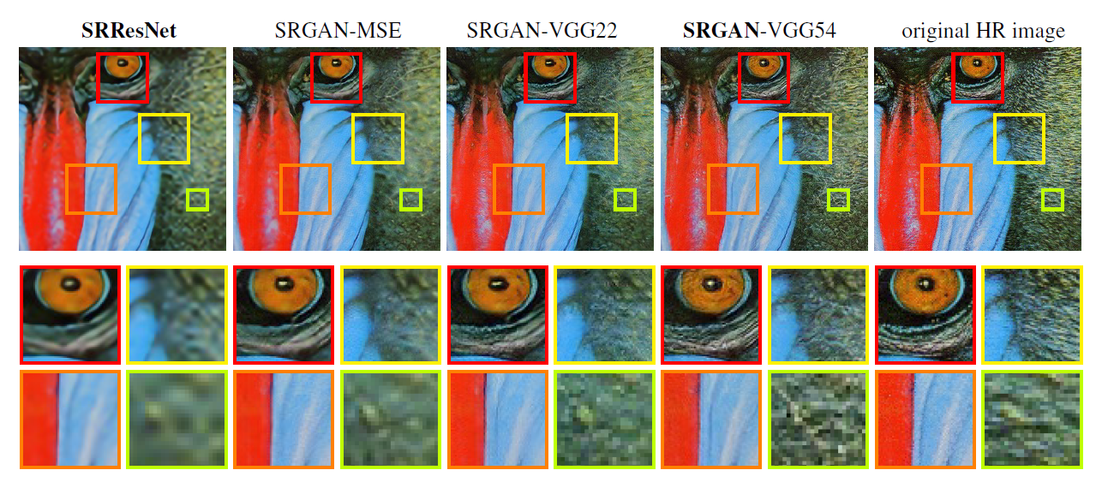
SRGAN

Slide 18
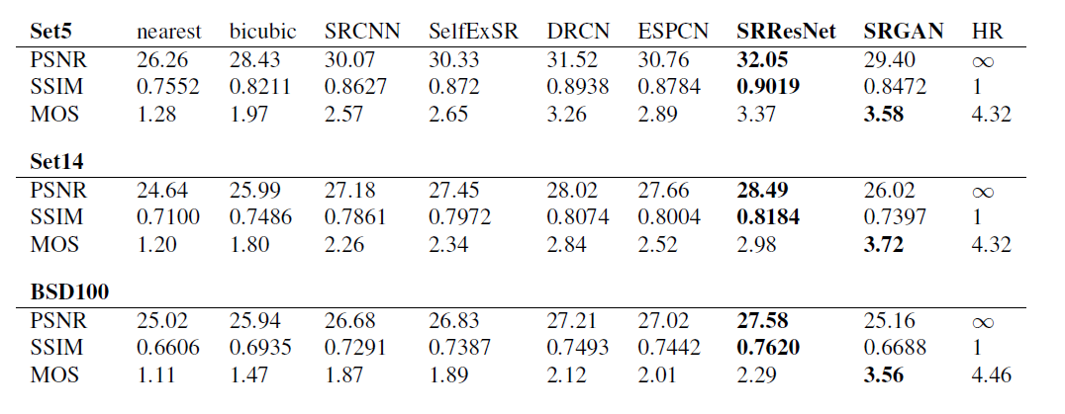
SRGAN

Slide 19
Analysis of Golf Swing Track
Using Correlation Matrix
JONGWOOK-SI
Kumoh National Institute of Technology, Korea
Dept. Of Computer Engineering

Slide 20
Analysis
시작
계열 1과 나머지와의 비교 -> 당연히 X,Y 모두 양의 선형관계

Slide 21
Analysis
계열 1과의 비교 | X’s r | Y’s r | score
계열 1 | 1.000000 | 1.000000 | 1.000000
계열 2 | 0.998918 | 0.982240 | 0.990579
계열 3 | 0.993204 | 0.953768 | 0.973486
계열 4 | 0.988803 | 0.914630 | 0.951717
궤적이 크게 다른 경우임에도 불구하고 굉장히 높은 score가 도출

Slide 22
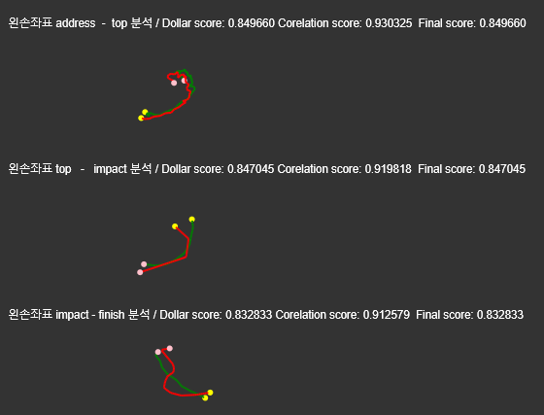
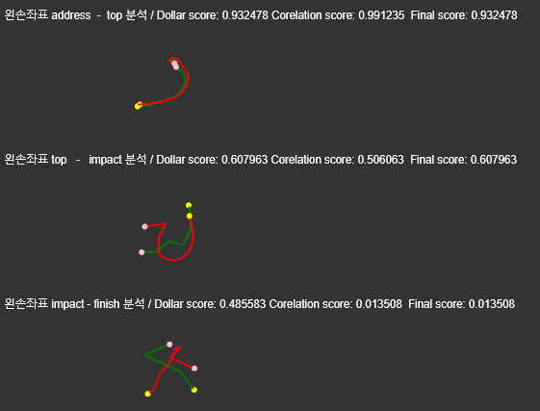
Analysis
둘다 양의 선형관계인 경우만 기존의 방법으로 score 도출

Slide 23
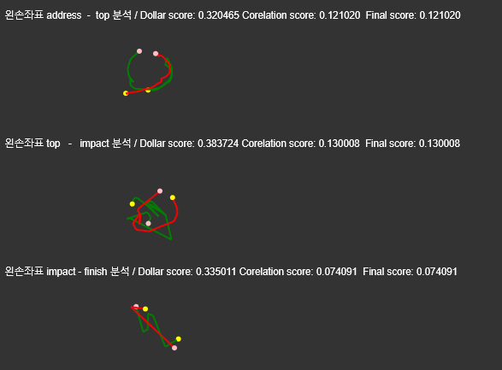
Analysis

Slide 24
Creating Image of Portrait Style
in Joseon Dynasty Period Using CycleGAN
JONGWOOK-SI
Kumoh National Institute of Technology, Korea
Dept. Of Computer Engineering

Slide 25
Idea Introduction
DataSet
 | A | B | SUM
Train | 326 | 312 | 638
Test | 44 | 49 | 91
Ratio | 88.11% | 82.46% | 85.74%
 | A | B | SUM
Train | 1103 | 1058 | 2261
Test | 210 | 156 | 366
Ratio | 84.01% | 87.15% | 86.08%

Slide 26
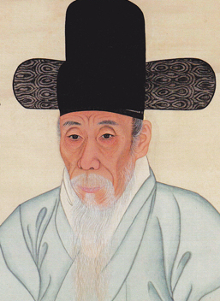
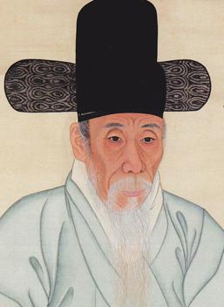
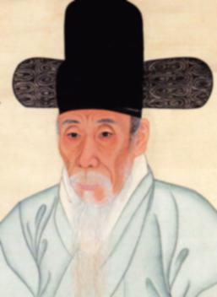
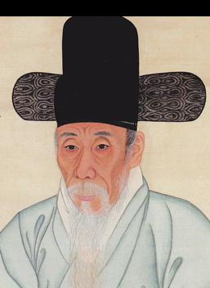
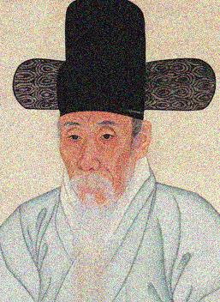
Idea Introduction
Data Augmentation
LR conversion Blur Translation noise

Slide 27
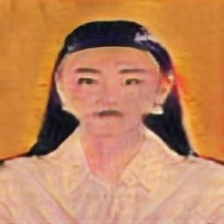

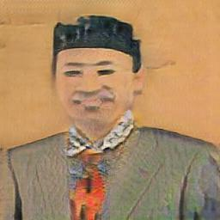
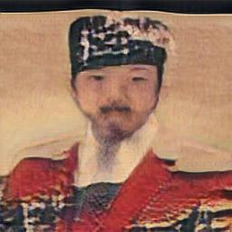
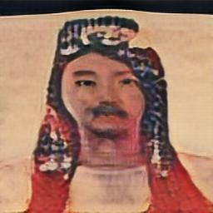
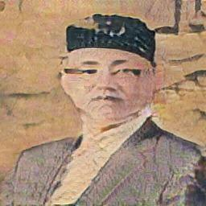
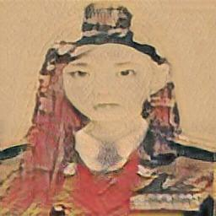
Conclusion
(60 / 200 epoch)
30% …

Slide 28
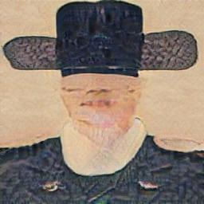
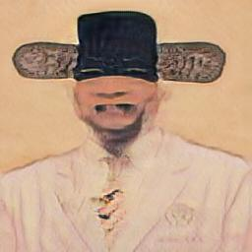
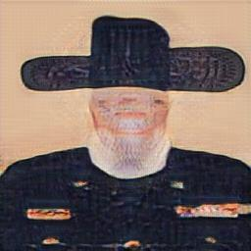
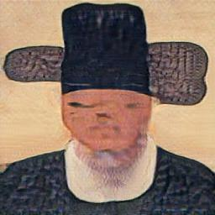
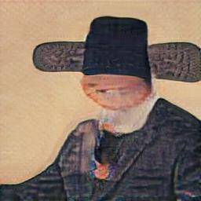
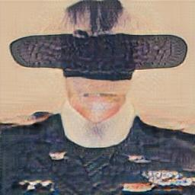
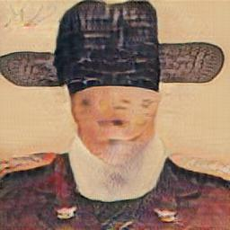
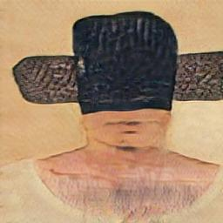
Conclusion
(60 / 200 epoch)
Where is eyes?

Slide 29


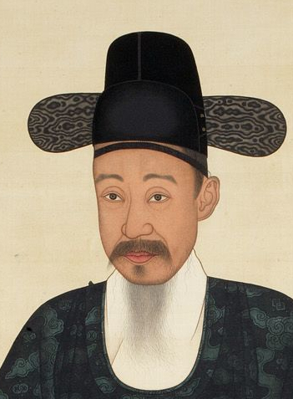
Conclusion
Problems

Slide 30
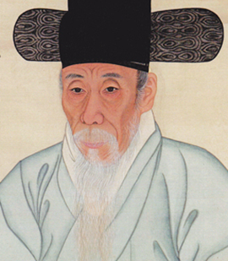
Conclusion
Solution

